Slide 1
Name: Em Sambath
Major: Business and Enterprise Management
E-mail: emsambath10@mekong.edu.kh
Academic Year: 2010-2011

Slide 2
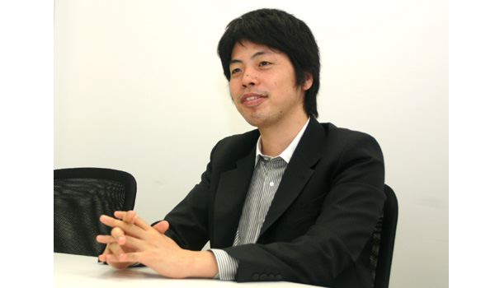
Young Entrepreneur in Japan
Background:
Name: Kenji Kasahara
Date of Birth: 6,December,1975
Nationality: Japanese
Company: Mixi
Education: Economics and IT Business at the University of Tokyo, and university seminar on management strategy.

Slide 3

Successful Story
He started up his first company and set up Mixi in 2004.
In February 2004 he launched "Mixi" the first social networking service in Japan
More than 10 million people are the user of Mixi.
May 2008, has 21.6 million users and an 80% share of the social networking market in Japan

Slide 4


Slide 5
Kenji Kasahara idea
“I'm sure you will meet with a smile
because you know true strength overcome sorrow and run! Courage you will surely reach in the future, if you try.”
Reference:
http://www.Facebook.com/people/kenji-kasahara

Slide 6
Thank for your paying attention

